Slide 1
Managing Human Capital in Retail
Achieving Alignment and Motivation Introduction
Matthew Bidwell, Associate Professor of Management

Slide 2
How HR Practices Support Organizational Performance
Abilities
Selective Hiring
Effective Development
Motivation
Opportunities to Participate
Generous pay and benefits
Pay for performance
Long term opportunities
Self-managing teams
Suggestion systems
Process design

Slide 3
Overview
Theories of motivation
Managing compensation
Job design

Slide 4
Managing Human Capital in Retail
Theories of Motivation
Matthew Bidwell, Associate Professor of Management

Slide 5
Expectancy Theory
Effort is the product of three factors
Expectancy: If I put forth effort, will it improve my performance?
Instrumentality: If I perform, what outcomes will occur?
Valence: How much do I value those outcomes?

Slide 6
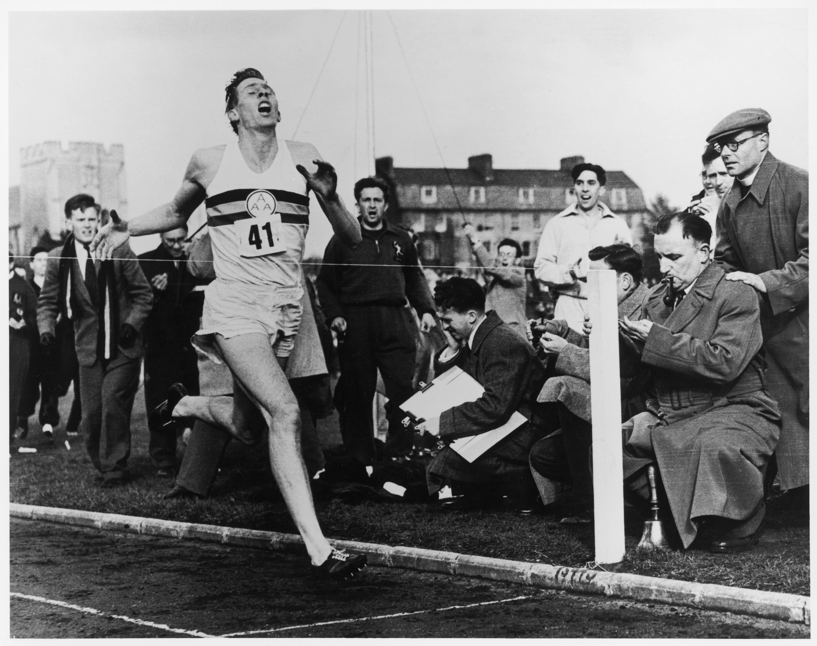

Slide 7
How Fast Can I Go?
Researchers asked cyclists to go around a virtual course as fast as possible on a stationary bike
After several trials, athletes learn their limits
Then asked cyclists to race against their own best effort
The cyclists’ avatar was actually faked to go 2% faster
Cyclists matched avatars, going significantly faster than prior performance
New York Times: September 19th, 2011

Slide 8
Some Determinants of Expectancy
If I put forth effort, will my performance improve?
Task difficulty
Individual control over performance
Individual skill levels
Confidence

Slide 9
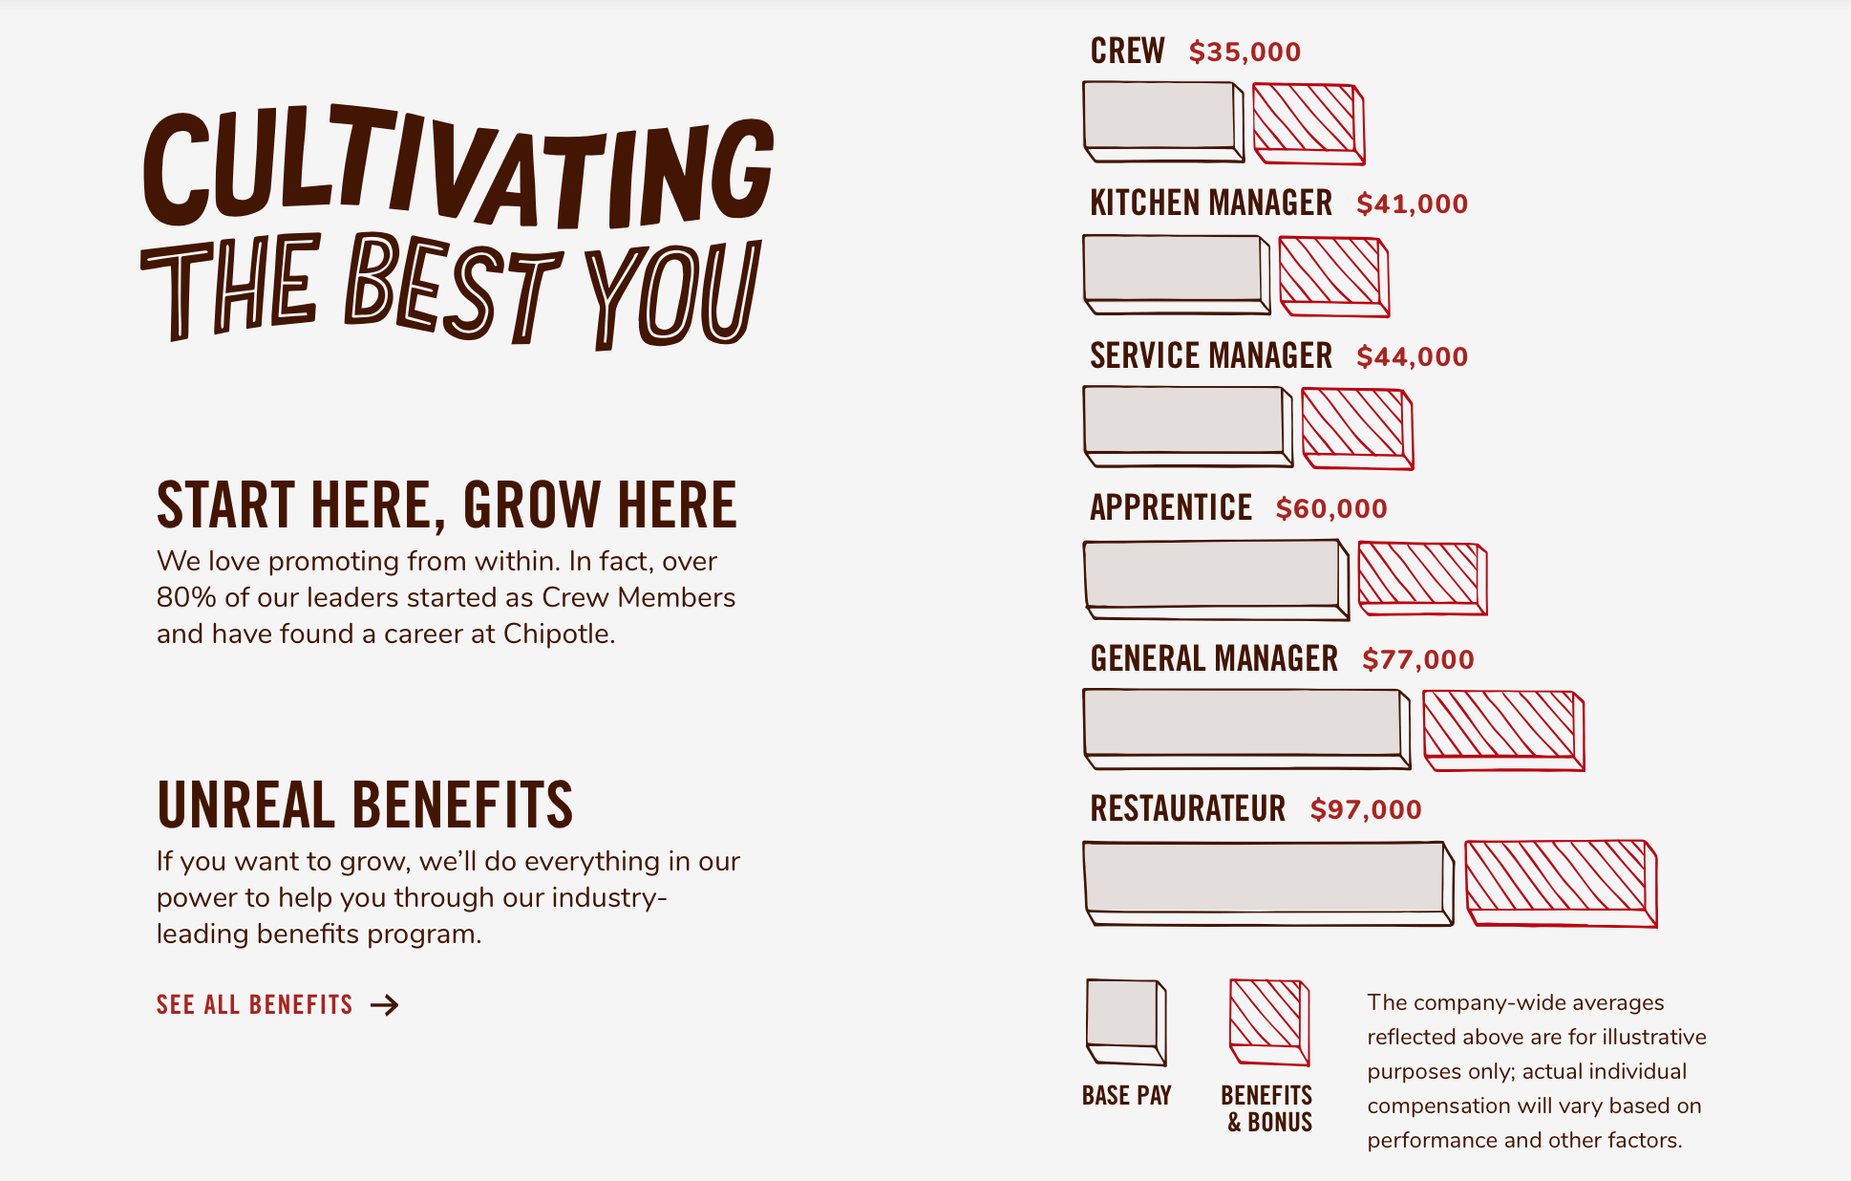
The Promotion Pathway at Chipotle

Slide 10
Managing Human Capital in Retail
Goal Setting and Motivation
Matthew Bidwell, Associate Professor of Management

Slide 11
Goal Setting
We motivate ourselves with goals and aspirations
Goals need to be specific and difficult enough to motivate

Slide 12
Goal Setting Lumberjacks
Study of goal setting in logging crews
39 truck drivers received difficult daily goals for the number of trips to the mill
35 drivers were in the control group
Results
15% increase in number of trips per day
Saved company $2.7 million in less than four months
When focusing on goals, people work harder, smarter, and have more incentive to perform well
Latham and Saari 1982

Slide 13
“
Here is what I think we should do. I think we should save 100,000 lives. And I think we should do that by June 14, 2006 – 18 months from today. ‘Some’ is not a number; ‘soon’ is not a time. Here’s the number: 100,000. Here’s the time: June 14 2006, 9:00am.”
— Institute for healthcare improvement
CEO Donald berwick

Slide 14
Goal Setting to Save Lives
Goal: Save 100,000 lives by June 14, 2006, 9:00 am
Challenge: How to track progress
Solution: Set intermediate goals that could be tracked
Needed to get 400,000 hospital beds in the campaign to reach the goal
Carefully tracked progress towards this target
Rao & Sutton, 2008

Slide 15
Managing Human Capital in Retail
Managing Compensation
Matthew Bidwell, Associate Professor of Management

Slide 16
Motivating Salespeople at Nordstrom
Goals
Commissions
Clear, measurable goals
Sales per hour targets for each two week period
Commission on sales above target, around 6.75%-10%
Ensure commitment
Failure to meet target results in reduced hours or termination
Meeting target results in increased hours
Performance against target publicly displayed
Regular competitions for prizes within and across departments
Great flexibility in how to serve customers
Maintaining difficulty
Awards to top 10% and top 1% of sellers

Slide 17
Hoping for A While Rewarding B
Hope for…
Reward…
Quality
Quantity
Teamwork
Individual performance
Ethical behavior
Results

Slide 18
Managing Human Capital in Retail
Setting the Right Pay Level
Matthew Bidwell, Associate Professor of Management

Slide 19
Pay Setting
Costs of increasing pay
Benefits of increasing pay
Higher wage bills
Attracting more, higher quality applicants
Improved retention
Employees work harder to retain job
Social exchange — increased psychological pressure to create value for employer

Slide 20
Pay Setting
Does the pay seem generous relative to what employees think they would get from other employers?
Do they feel it is generous relative to what other employees are getting?
Importance of a sense of equity in compensation

Slide 21
Pay Setting
Consider the effects of pay setting
Job retention and employee motivation
Social exchange
Differentials

Slide 22
Managing Human Capital in Retail
Motivation through Job Design
Matthew Bidwell, Associate Professor of Management

Slide 23
Expectancy Theory and Job Design
Expectancy: Will my efforts shape my performance?
Autonomy
0.71
Instrumentality: If I perform, what is the outcome?
Feedback
0.56
Valence: How much do I value the work itself?
Task significance
Task identity
Skill variety
0.35
0.32
0.67

Slide 24

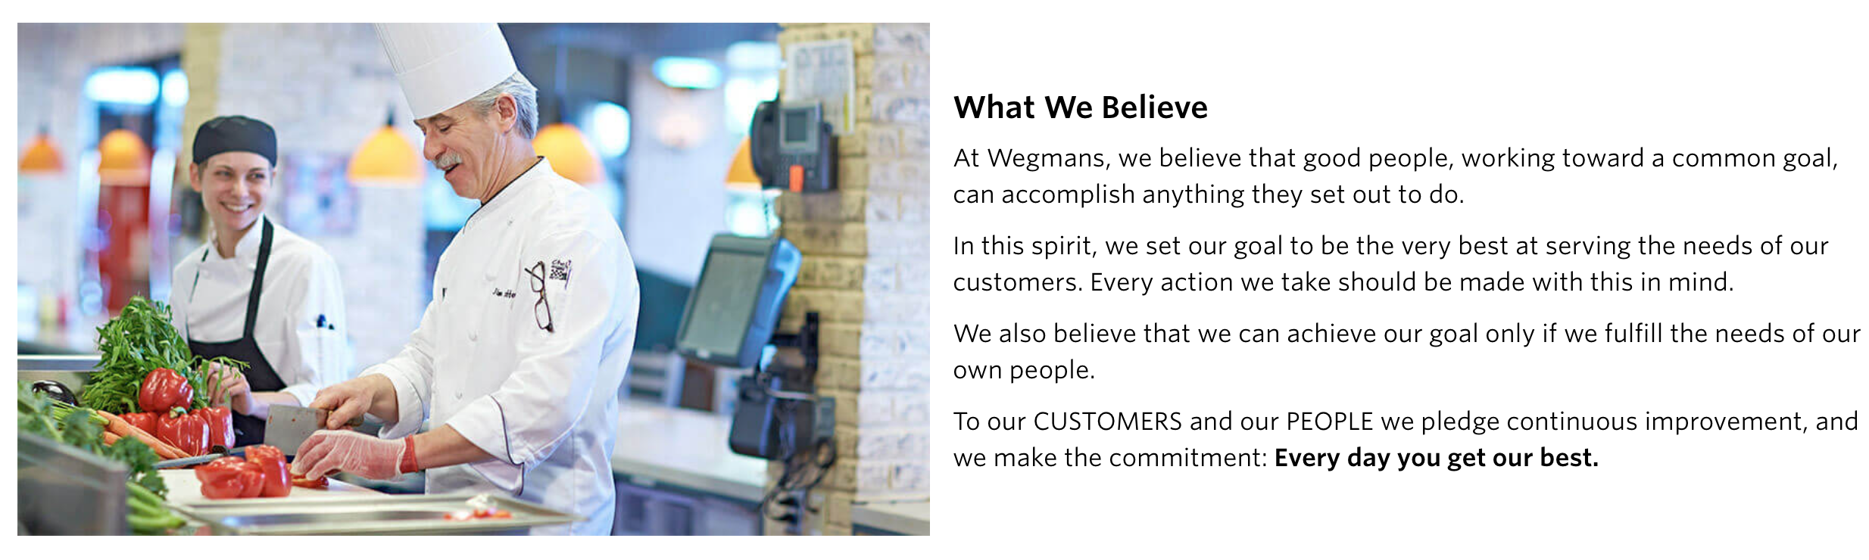
Wegmans Company Philosophy

Slide 25
Managing Human Capital in Retail
Course Conclusion
Matthew Bidwell, Associate Professor of Management

Slide 26


